Slide 1
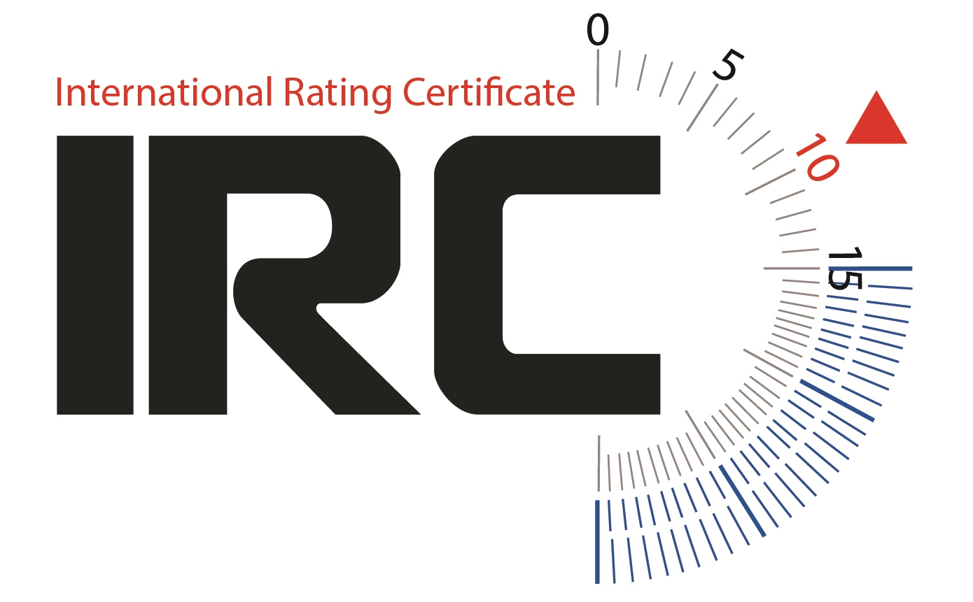
Overhangs
International Rating Certificate

Slide 2
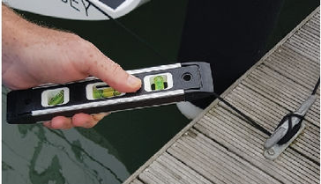
Overhangs Equipment
Dinghy or well placed pontoon
Floating (wooden) ruler
Spirit level with 45 deg bevel
2 plumb bobs
Sundry string
Tape
Notes:
List equipment needed

Slide 3
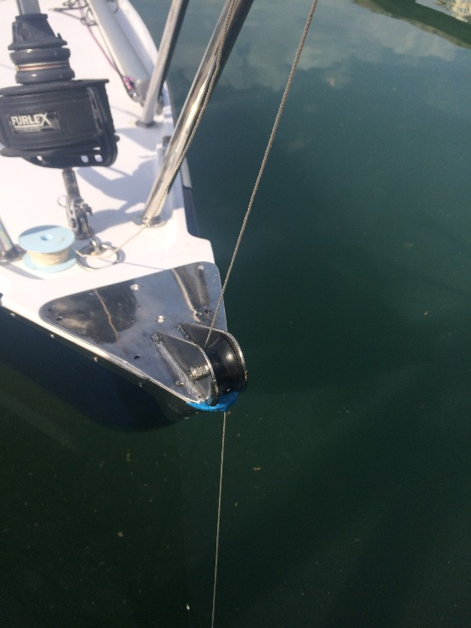
Bow Overhang
Notes:
Often easiest to measure BO – x (Rather than x)
If plumb bob is immersed watch out for tide
Watch out for the plumb bob being deflected around bowsprits & bobstays

Slide 4
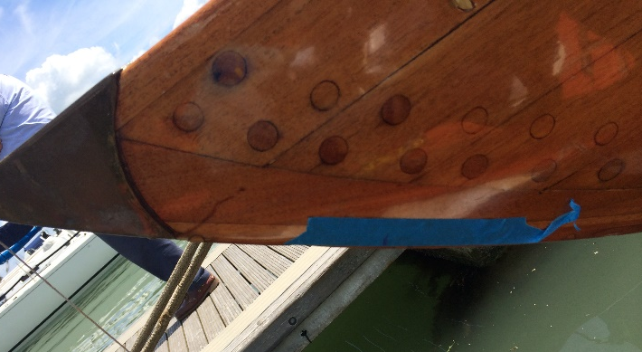
Bow Overhang
Classic Bows

Slide 5
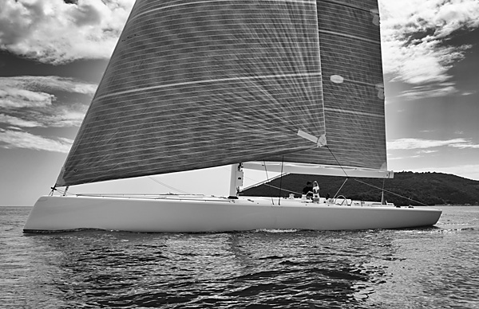
Bow Overhang
Inverse Bow

Slide 6
Stern Overhang
Stern overhang can be difficult
Ignore the skeg
If rudder is above waterline, measure SO on both sides
In all cases y should be supplied
Notes:
Stern (SO): Measurement can be difficult, particularly with modern designs with transoms low to the water. A dinghy or float is essential with an assistant to hold this in position. As with the bow, position the end of a floating ruler against the required measurement point and pivot the ruler about this point towards the plumb line. Repeat as many times as necessary to achieve a consistent result.
Note that on boats with skegs, stern overhang is measured to the intersection of the actual hull (the canoe body) with the water, ignoring the skeg.
If the upper end of the rudder is above the waterline, it is preferable to measure SO on both sides.
In all cases, the dimension 'y' should also be supplied. Measurement is straightforward.

Slide 7
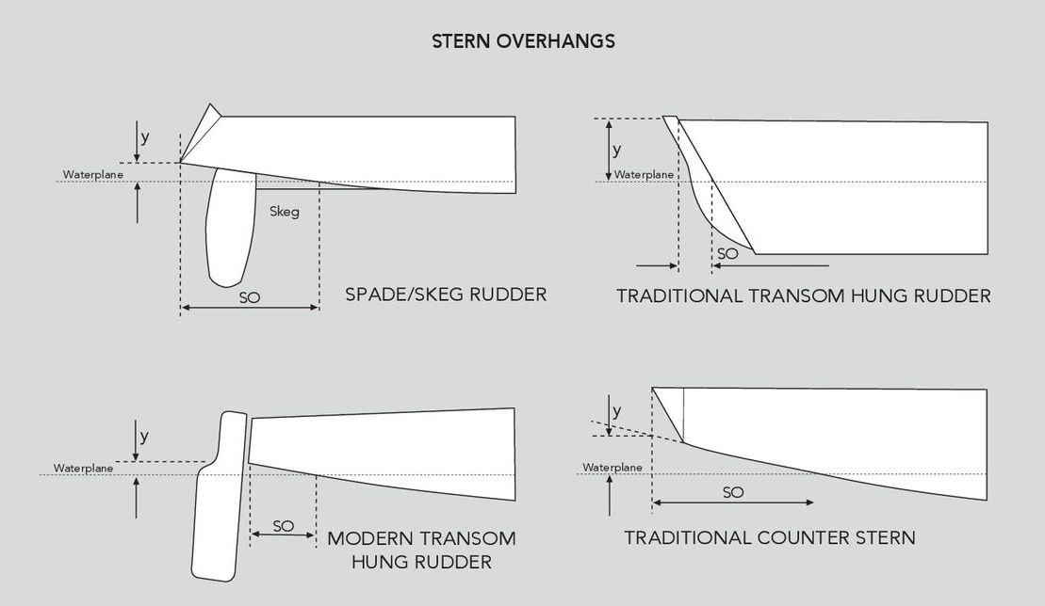
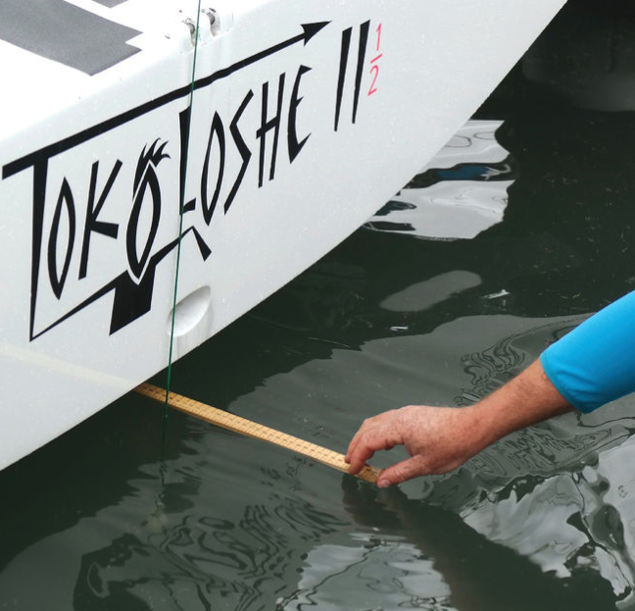
Stern Overhang

Slide 8
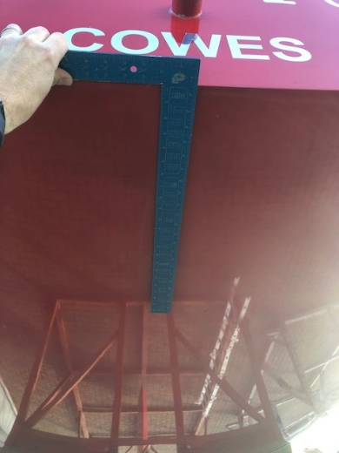
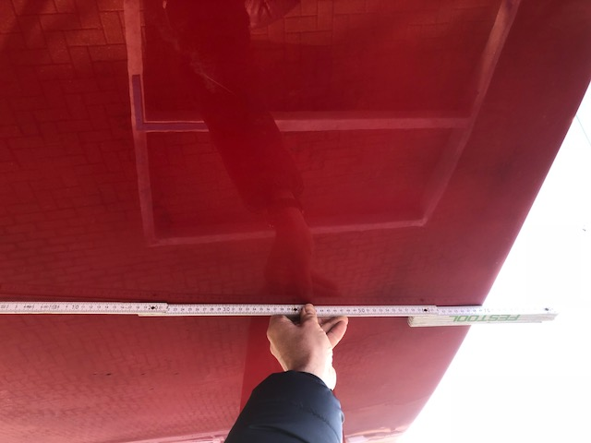
Twin Rudders or Fully Immersed Rudders
Try & add CL reference mark when boat is out of water / lifted for weighing.
You can double check SO by measuring along hull surface.

Slide 9
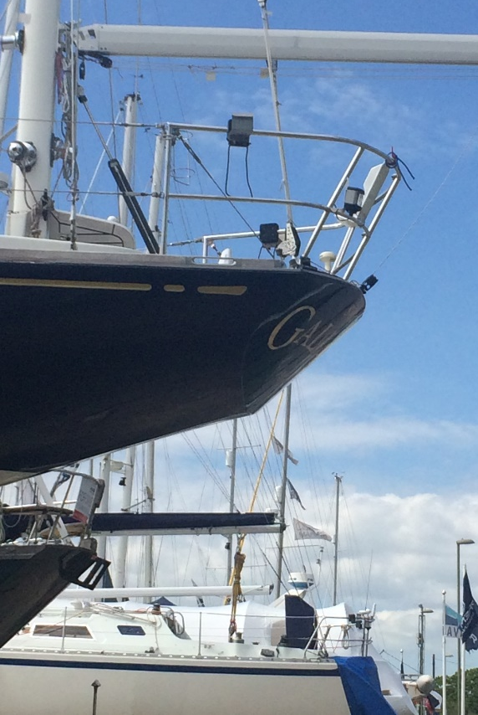
Stern Overhang
Notes:
Use long spirit level or straight edge

Slide 10
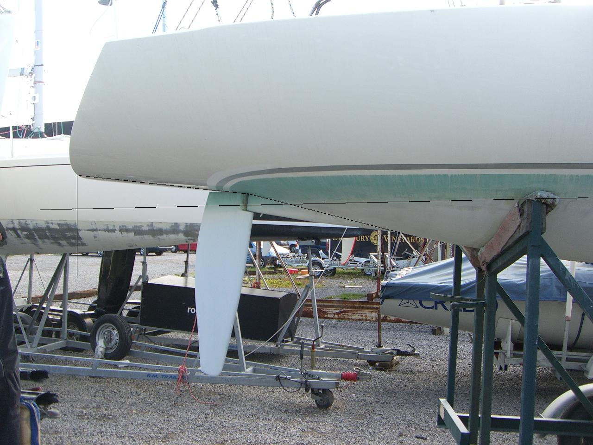
IOR Sterns / Skegs
Notes:
Don’t forget to ignore the skeg
Measure either side of skeg to check measurement

Slide 11
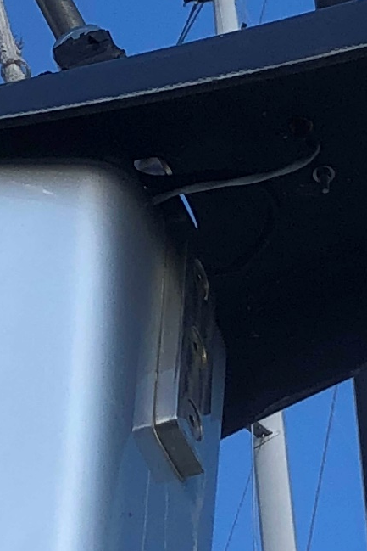
Overhang Measurement Summary
BO:
Hang plumb line over bow excluding any hull fittings.
Position a floating rule against the bow at the waterline.
Swing the rule against the plumb line.
Repeat to achieve consistency.
x and h:
If zero, report ‘zero’ – x and h could be on the stem
Establish the 45⁰ tangent on the bow knuckle.
Measure vertically from the tangent to the water for h.
Measure horizontally from the tangent to the plumb line and
SUBTRACT from BO for x.
SO:
Can be difficult! Needs to be done from a dinghy.
Hang plumb line over stern excluding any hull fittings
Position a floating rule against the hull at the waterline.
Swing the rule against the plumb line.
Repeat to achieve consistency.
y:
Measure vertically from the tip of the transom to the water.

